Slide 1
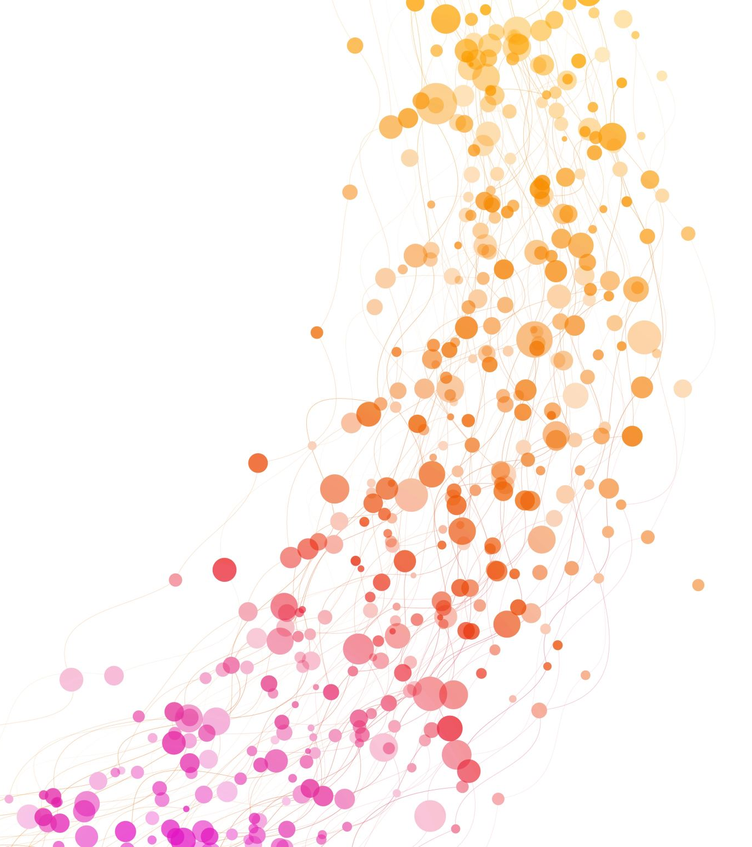
COST- Unit 5
Least Square Parabola

Slide 2
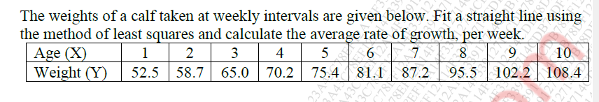
Question
Estimate weight of a calf at week 13.
If weight of calf is 200 pounds.
Steps-
Decide Dependent and Independent Variable
Write equations of lest square lines
Form Table
Get values of a0 and a1
Write final equation

Slide 3
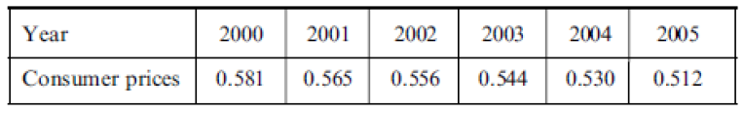
Question
Following table gives the purchasing power of the dollar as measured by consumer prices according to the U.S. Bureau of Labour Statistics, Survey of Current Business.
Find the equation of the trend.
Estimate the consumer price in 2008 assuming the trend continues for 3 more years.

Slide 4

THT
Table below shows the birth rate per 1000 population during the years 1998 through 2004.
Find equation of trend.
Predict the birth rate in 2010, assuming the present trend continues.

Slide 5
Regression
Regression analysis is a statistical method that helps us to analyse and understand the relationship between two or more variables of interest.
Regression curve of Y on X : to estimate the value of a variable Y corresponding to a given value of a variable X
Regression curve of X on Y : to estimate the value of a variable X corresponding to a given value of a variable Y

Slide 6
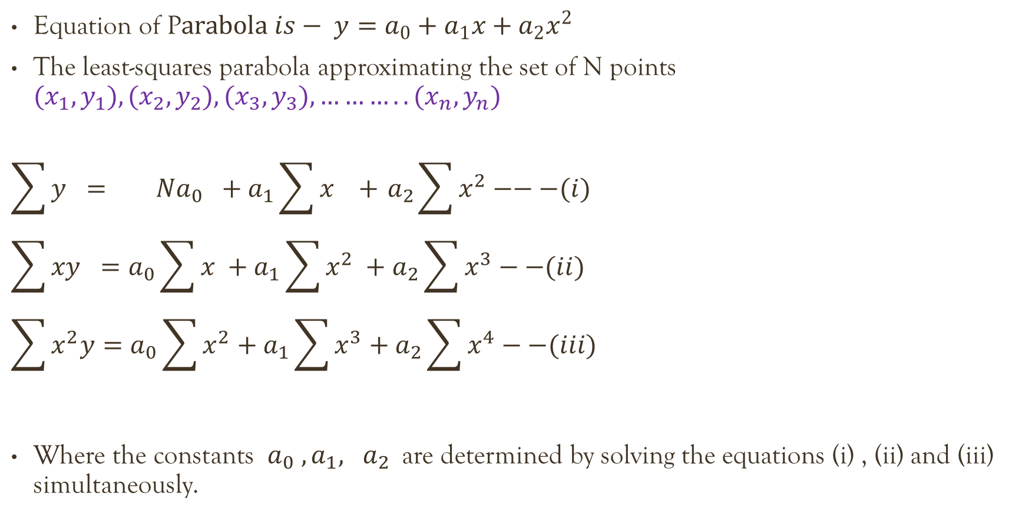
Least Square parabola
Equation of P$arabola is− y=a_{0}+a_{1}x+a_{2}x^{2}$
The least-squares parabola approximating the set of N points ${(x}_{1},y_{1}), {(x}_{2},y_{2}), {(x}_{3},y_{3}), ………..{(x}_{n},y_{n})$
$$\sum{y} = Na_{0} +a_{1}\sum{x} +{ a}_{2}\sum{x^{2}}−−−(i)$$
$$\sum{xy} =a_{0}\sum{x} +a_{1}\sum{x^{2}} +a_{2}\sum{x^{3}}−−(ii)$$
$$\sum{x^{2}y}=a_{0}\sum{x^{2}}+a_{1}\sum{x^{3}}+a_{2}\sum{x^{4}}−−(iii)$$
Where the constants $a_{0} ,a_{1}, a_{2}$are determined by solving the equations (i) , (ii) and (iii) simultaneously.

Slide 7

Question
Fit a second-degree parabola by considering X as independent variable
X | 1 | 2 | 3 | 3 | 4 | 5 | 6
Y | 2 | 6 | 8 | 10 | 11 | 10 | 9
$$\sum{y} = Na_{0} +a_{1}\sum{x} +{ a}_{2}\sum{x^{2}}−−(i)$$
$$\sum{xy} =a_{0}\sum{x} +a_{1}\sum{x^{2}} +a_{2}\sum{x^{3}}−−(ii)$$
$$\sum{x^{2}y}=a_{0}\sum{x^{2}}+a_{1}\sum{x^{3}}+a_{2}\sum{x^{4}}−−(iii)$$

Slide 8
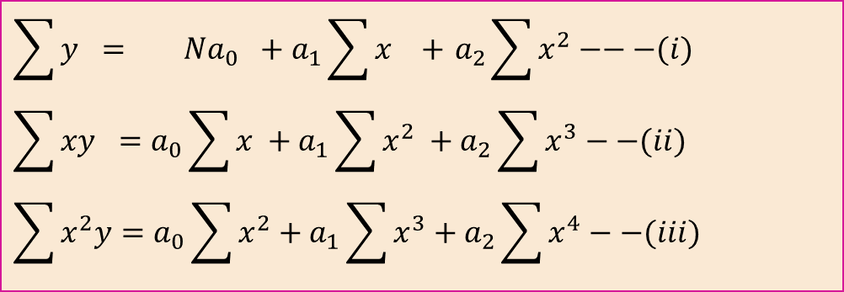
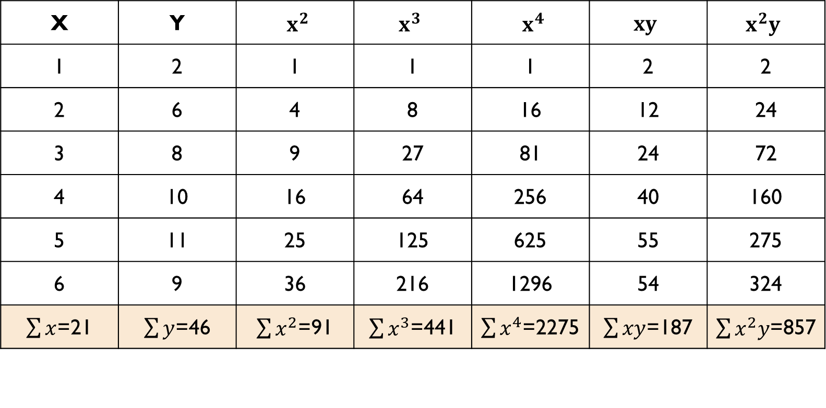
Solution
$$\sum{y} = Na_{0} +a_{1}\sum{x} +{ a}_{2}\sum{x^{2}}−−−(i)$$
$$\sum{xy} =a_{0}\sum{x} +a_{1}\sum{x^{2}} +a_{2}\sum{x^{3}}−−(ii)$$
$$\sum{x^{2}y}=a_{0}\sum{x^{2}}+a_{1}\sum{x^{3}}+a_{2}\sum{x^{4}}−−(iii)$$
X | Y | $x^{2}$ | $x^{3}$ | $x^{4}$ | $xy$ | $x^{2}y$
1 | 2 | 1 | 1 | 1 | 2 | 2
2 | 6 | 4 | 8 | 16 | 12 | 24
3 | 8 | 9 | 27 | 81 | 24 | 72
4 | 10 | 16 | 64 | 256 | 40 | 160
5 | 11 | 25 | 125 | 625 | 55 | 275
6 | 9 | 36 | 216 | 1296 | 54 | 324
$\sum{x}$=21 | $\sum{y}$=46 | $\sum{x^{2}}$=91 | $\sum{x^{3}}$=441 | $\sum{x^{4}}$=2275 | $\sum{xy}$=187 | $\sum{x^{2}y}$=857

Slide 9
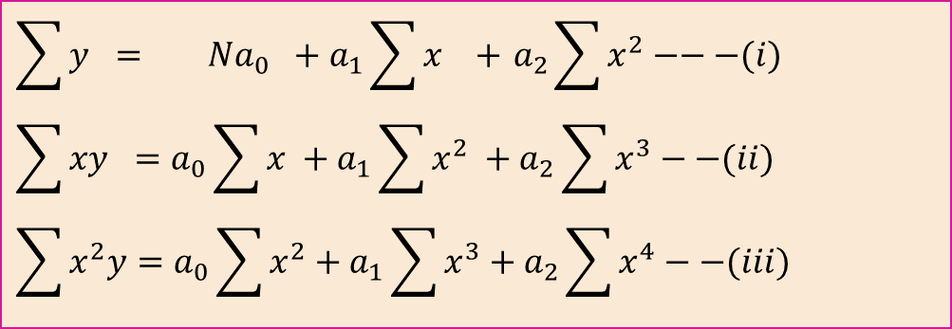
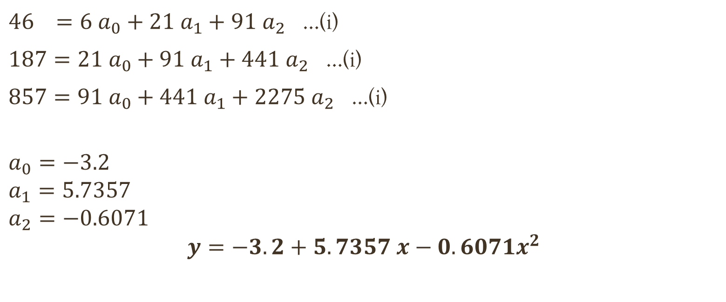
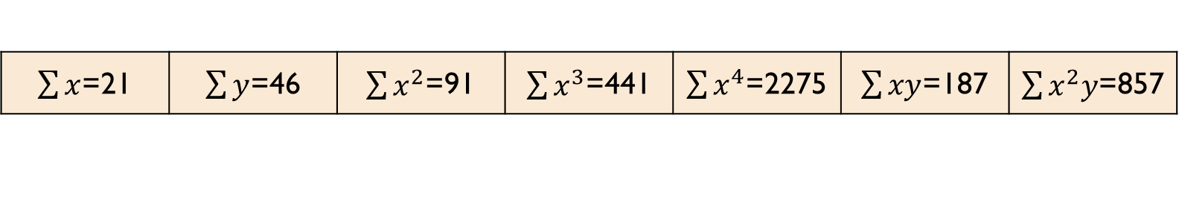
Cont. ..
$$\sum{y} = Na_{0} +a_{1}\sum{x} +{ a}_{2}\sum{x^{2}}−−−(i)$$
$$\sum{xy} =a_{0}\sum{x} +a_{1}\sum{x^{2}} +a_{2}\sum{x^{3}}−−(ii)$$
$$\sum{x^{2}y}=a_{0}\sum{x^{2}}+a_{1}\sum{x^{3}}+a_{2}\sum{x^{4}}−−(iii)$$
$\sum{x}$=21 | $\sum{y}$=46 | $\sum{x^{2}}$=91 | $\sum{x^{3}}$=441 | $\sum{x^{4}}$=2275 | $\sum{xy}$=187 | $\sum{x^{2}y}$=857
$46 =6 a_{0}+21{ a}_{1}+{91 a}_{2}$ …(i)
$187=21 a_{0}+91{ a}_{1}+{441 a}_{2}$ …(i)
$857=91 a_{0}+441{ a}_{1}+{2275 a}_{2}$ …(i)
$$a_{0}=−3.2$$
$$a_{1}=5.7357$$
$$a_{2}=−0.6071$$
$$y=−3.2+5.7357 x−0.6071x^{2}$$
$$y=a_{0}+a_{1}x+a_{2}x^{2}$$

Slide 10
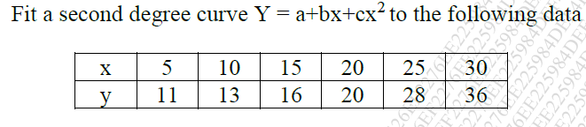
Question

